Slide 1
PART II

Slide 2
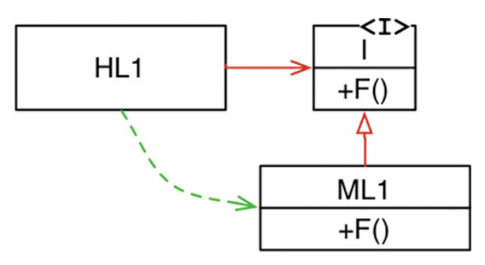
depends on
interface
High Level
implements
Flow of control (aka execution flow)
Medium Level
Source code dependency direction
Dependency Inversion: The source code dependency direction does not follow the execution flow. Polymorphism allows us to decided the direction of source code dependency that is best for our architecture.

Slide 3
Independently Deployable Independently Developable
UI
Business Rules
DB
Flow of control (aka execution flow)
Implements
Implements
UI <I>
DB <I>
Source code dependency direction
Architectural Boundary
The “Business Rules” define the interface it needs from the UI and it is up to the UI to implement it. Hence, the UI depends on the Business Rules (more specifically on the interface defined by the BRs).

Slide 4
PART III

Slide 5
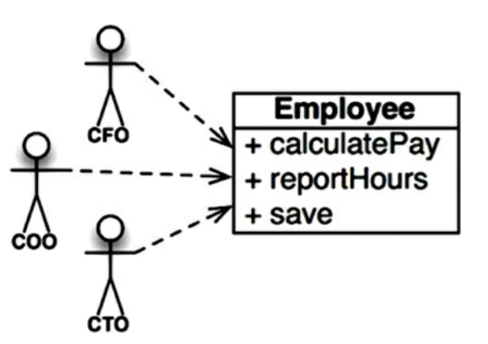
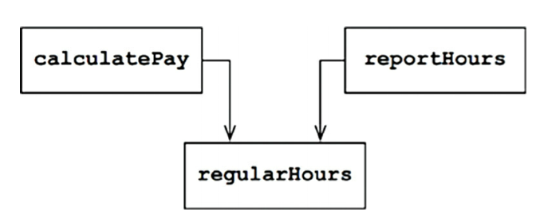
Each of these operations are used by (and are the responsibility of) different “actors” in the real world.
Internally, the Employee module uses a shared method regularHours to calculate data used by different actors.
Employee
If the CFO orders a tweak in the way hours are calculated for payroll purposes, the tweak will indirectly change how reportHours work for operations purposes. This is accidental duplication of logic.

Slide 6
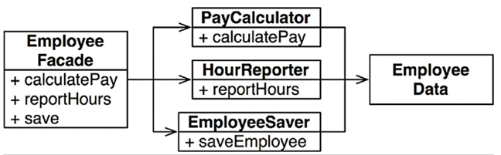
Simple data structure with no methods.
- Has very little code. - Exists just for convenience to avoid having to deal with 3 separate classes.
- Instantiate and delegate.
Do all the heavy lifting
Very slim public interface (probably one method) but may have many private methods to support the functionality

Slide 7
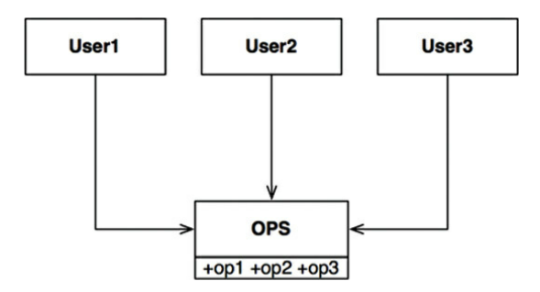
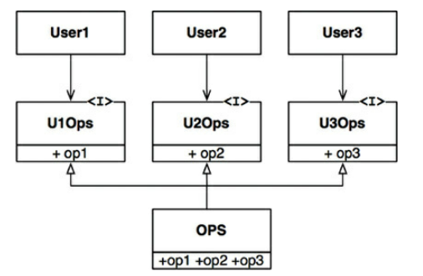
Code Violating ISP
ISP Compliant Code
Any change in OPS will require all 3 User classes to be recompiled and redeployed
If the make each User class only depend on the actual operations they depend on, recompilation and redeployment only need to happen if the dependent operation changes.

Slide 8
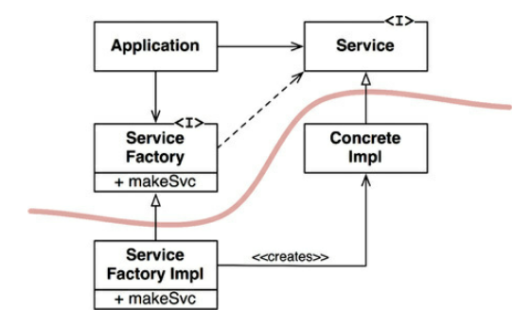
ServiceFactory<I>.makeSvc returns an object that complies with the Service <I>.
Abstractions
Architectural Boundary
Concretions
*Lines only cross in one direction.
*Lines always flow from the concrete to the abstract.
*The flow of control is inverted from the source code dependency.

Slide 9
PART IV

Slide 10
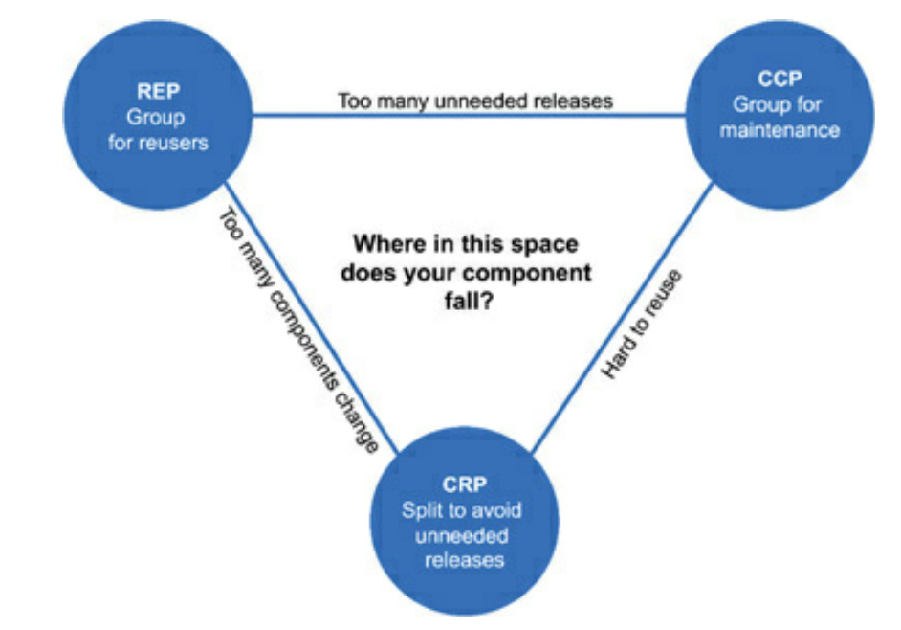
(cost of abandoning CRP)
(cost of abandoning CCP)
(cost of abandoning REP)

Slide 11
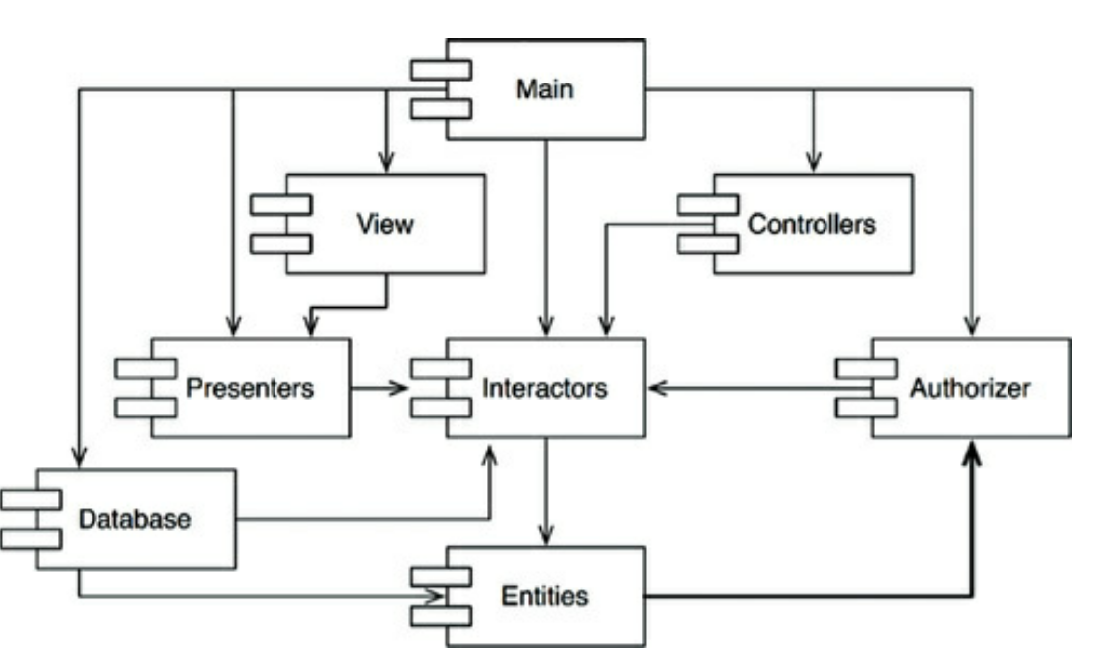
The Problem
Entities needs a pinned version of Authorizer to be built.
Authorizer needs a pinned version if Interactors to be built.
Interactor needs a pinned version of Entities.
All components depend on each other and the only way to build them is to coordinate the build versions between them. They now behave like a single coupled component.

Slide 12
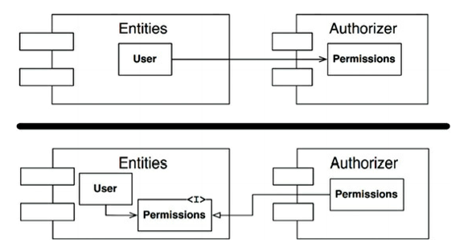

Slide 13
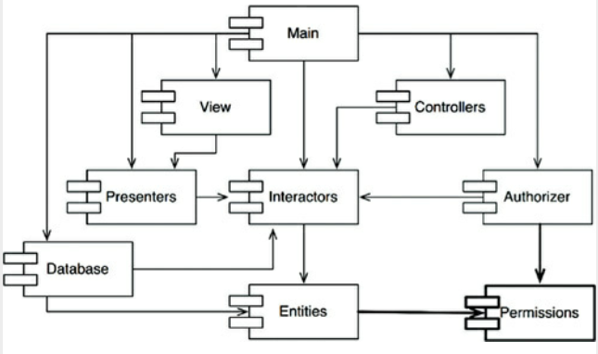

Slide 14
PART V

Slide 15
Use Case: Add Order
Use Case: Delete Order
UI
UI
Application Specific Business Rules (e.g. validations)
Application Specific Business Rules (e.g. validations)
Application Independent Business Rules (e.g. approval process)
Application Independent Business Rules (e.g. refund process)
Persistence
Persistence
… among others…
… among others…

Slide 16
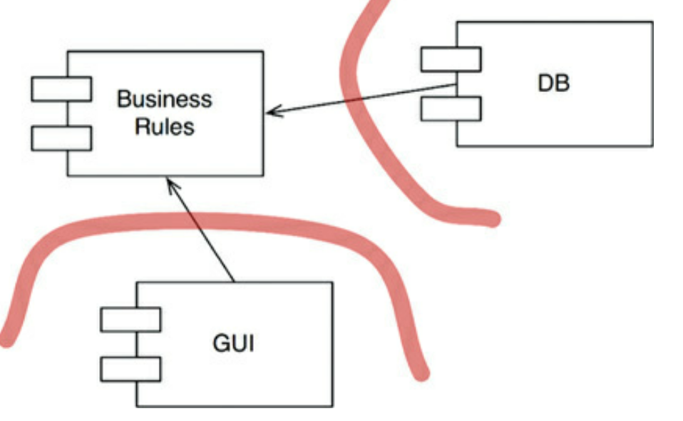
The DB and the GUI components act as plugins to the business rules. This establishes a pattern for the other components of the system.

Slide 17
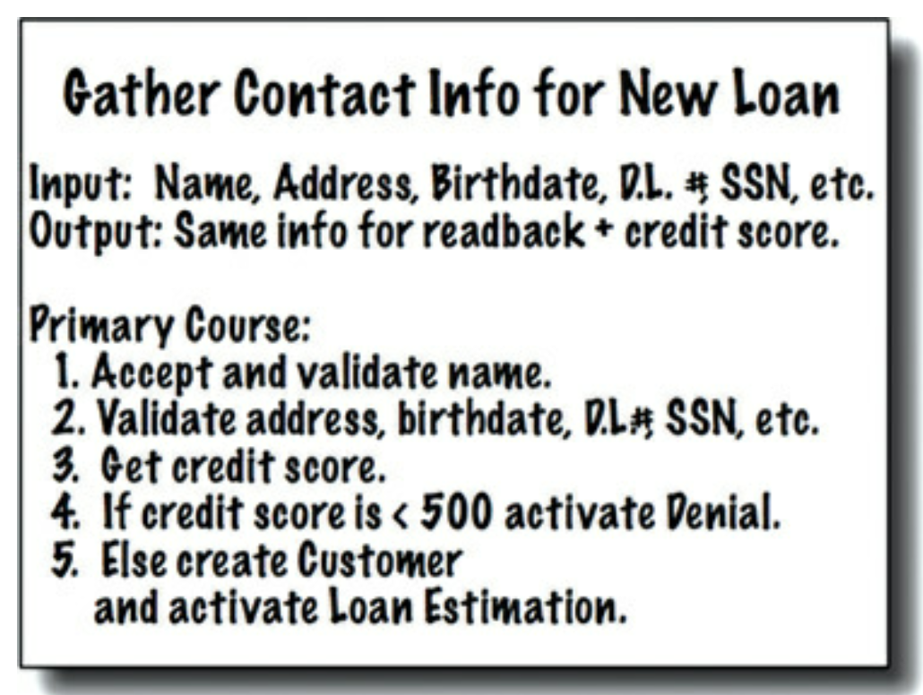
Use Case Example
Use Cases coordinate the use of Entities

Slide 18
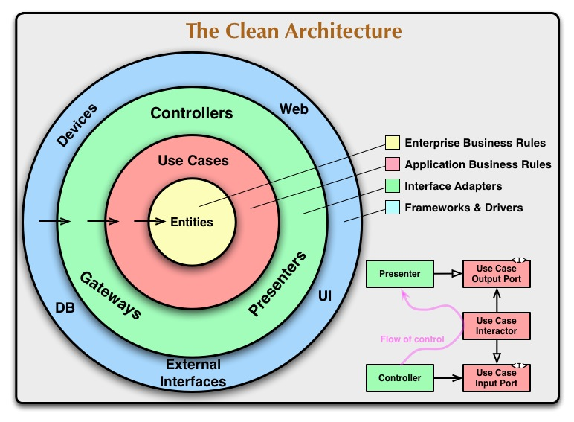
Crossing Boundaries Example

Slide 19
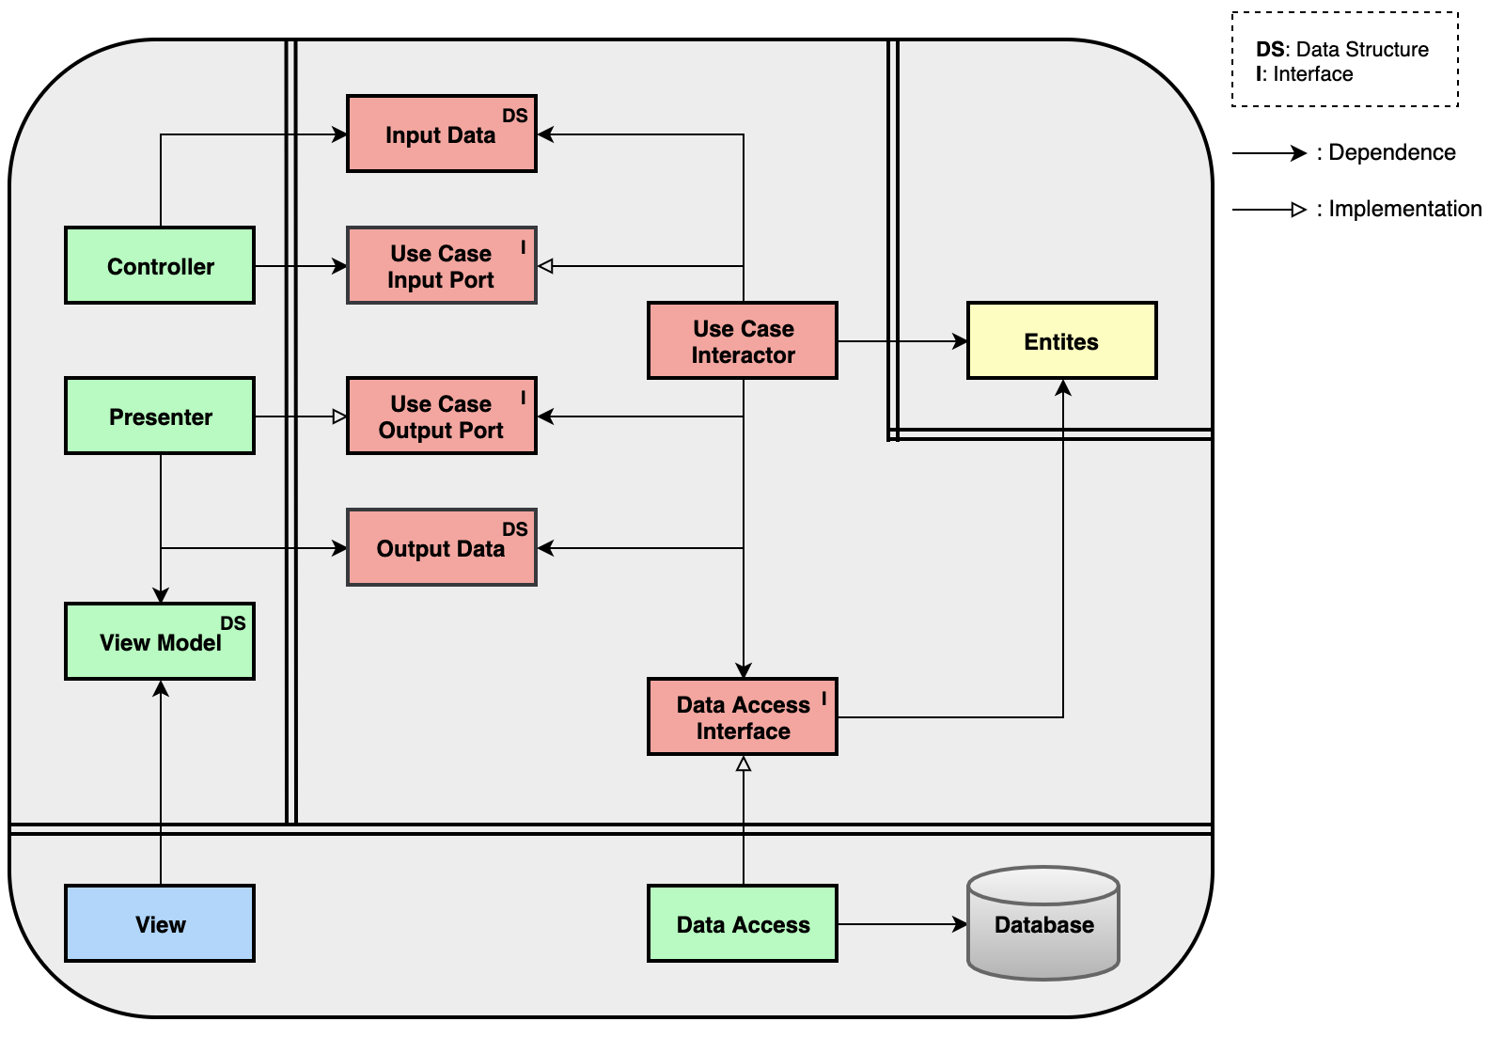
Note: This is a source code dependency diagram. It doesn’t determine anything about the flow of control from the actual implementation.

Slide 20
Split Interfaces, Group Implementation
No Interfaces, Group Implementation
Use Case: List All Users
Use Case: List All Admin Users
Use Case: List All Users
Use Case: List All Admin Users
List All Users Data Access <Interface>
List All Admin Users Data Access <Interface>
Users Repository implements both interfaces
Users Repository implements read and write needs for both use cases
- If the Users Repository Changes, both use cases need to be recompiled. - Some work will be required to re-establish the strict vertical boundary.
The source code dependency boundary is being crossed in the wrong direction
Higher risk of making it hard to split vertically in the future if needed.

Slide 21
Use Case: List All Users
Use Case: List All Admin Users
Users Façade (single place for all user related reads and writes)
Users Repository
Admin Users Repository
The source code dependency boundary is being crossed in the wrong direction
The ”splitable” components are kept under the hood but centralized in the façade for cognitive simplicity.

Slide 22
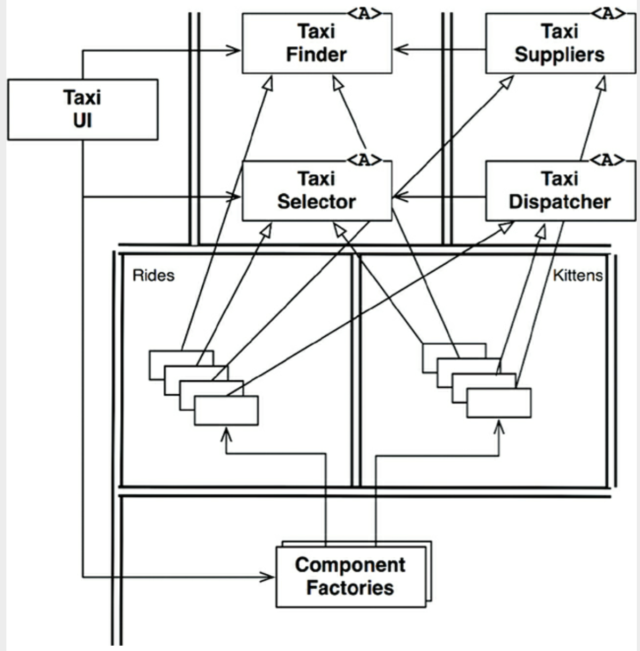
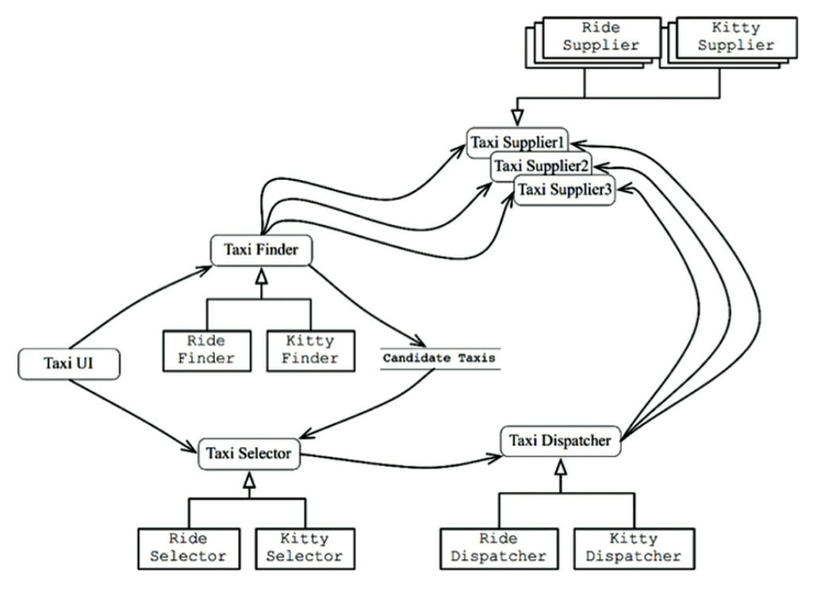
Parcel Supplier
Parcels
Parcel Finder
Parcel Selector
Parcel Dispatcher
Implementation of the Architecture in the Current State of Microservices
- Each service represents one horizontal layer for each use case (business line). Not ideal but we cannot do anything about this. - We use internal component boundaries so that code for the different businesses lines is kept separate.
The Architecture of the System Ignoring the Current Microservices
- It maintains the Rides and the Parcels business logic separate

Slide 23
PART VI

Slide 24
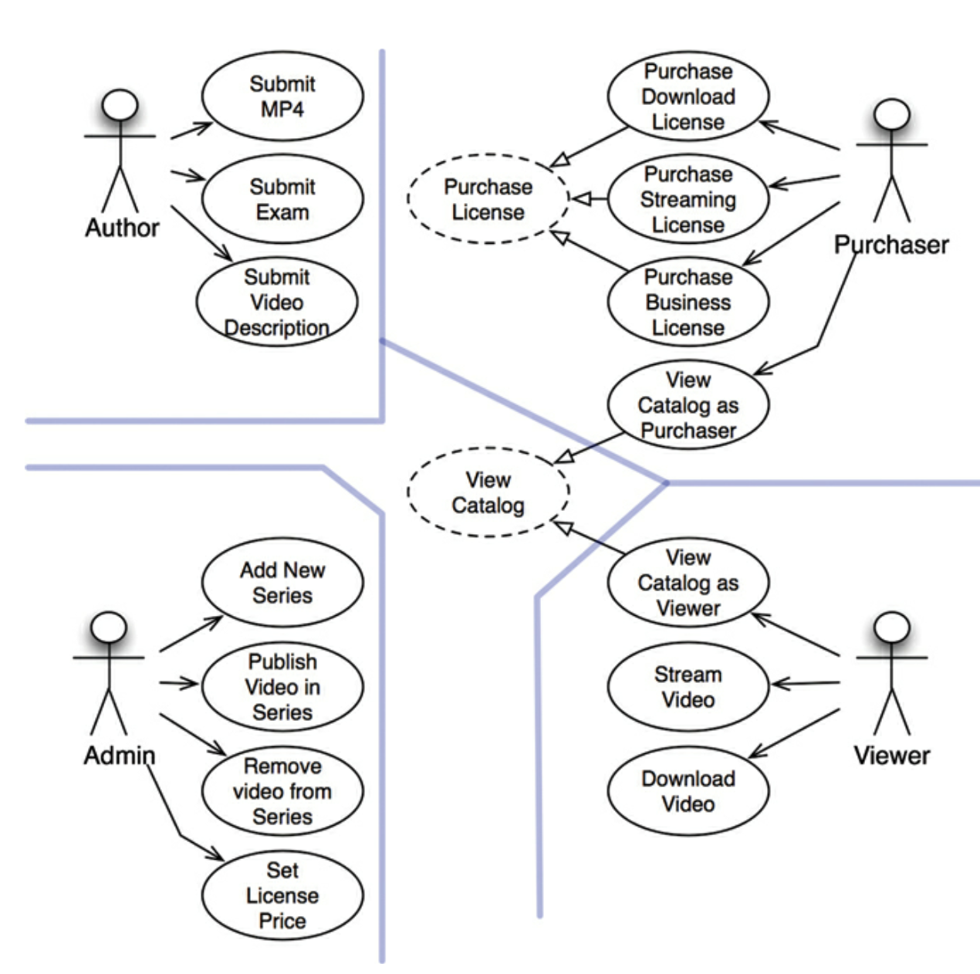
Abstract Use Cases
They might be defined as an abstract class that is implemented by the concrete use cases.
Or they might not be created as code at all and are just mentioned to recognize the similarity.
Regardless, of the above. Keep the concrete use cases separate since they change for different reasons.

Slide 25
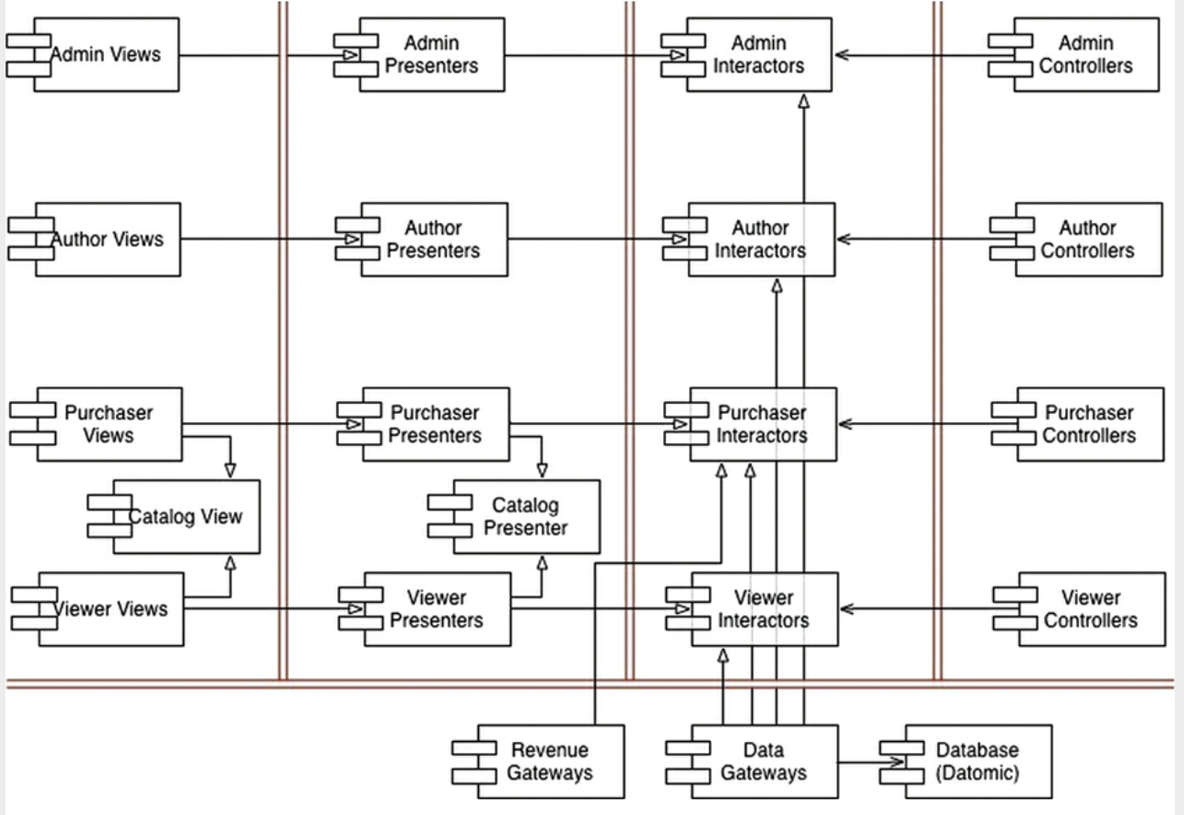
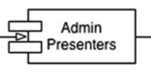
A component: we keep the options open on the decoupling mode needed for the system. Worst case scenario each component could be an independent .jar. Most likely we will bundle up multiple components into one jar or service to simplify deployment.
Architectural Boundaries: boundary crossing follows the dependency rule.
Code is divided by Actors.

Slide 26
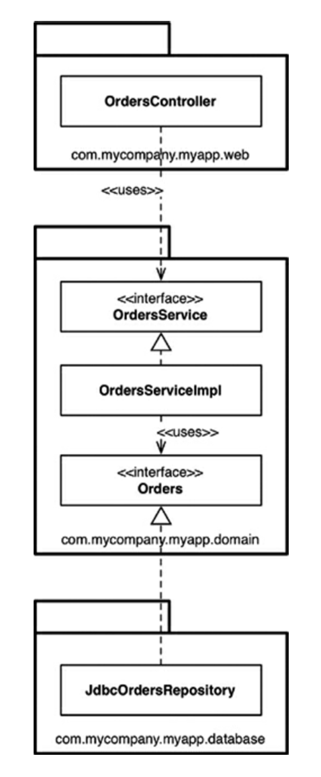
Outside
Inside
Outside

Slide 27
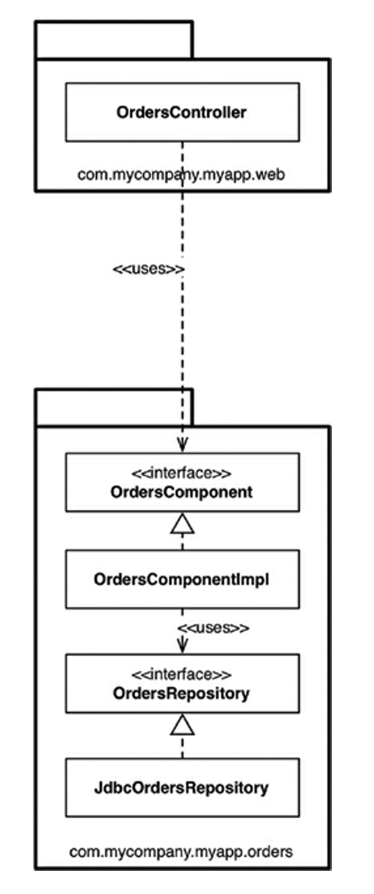
The “orders component”
There is a single place to go when external codes needs something from orders.
Package visibility modifiers only make this visible from the outside
Internally, the separation of concerns and the dependency rule are still maintained.
A well-defined component like this inside a monolith is a steppingstone to a micro-service (in case there was a need to extract it).

